Slide 1

Cellphone Sales DataSet
My Ha

Slide 2
Table of contents
01
02
03
04
05
Data Overview
Data Importation
Creating Keys
ER Diagram
Insights

Slide 3
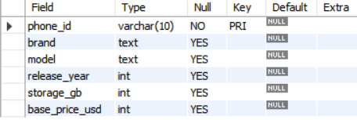
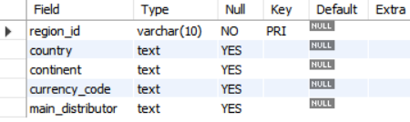
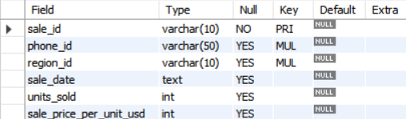
Data Overview
phones.csv -> This table lists the mobile phone models available for sale.
regions.csv -> This table lists the different countries and regions where sales are tracked.
sales.csv -> This table links phones and regions, showing the actual sales transactions.
→ serves as a junction table connecting the other two tables

Slide 4
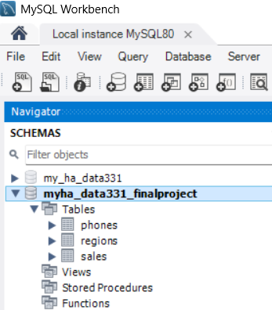
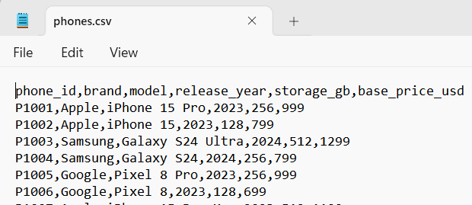
Data Importation

Slide 5
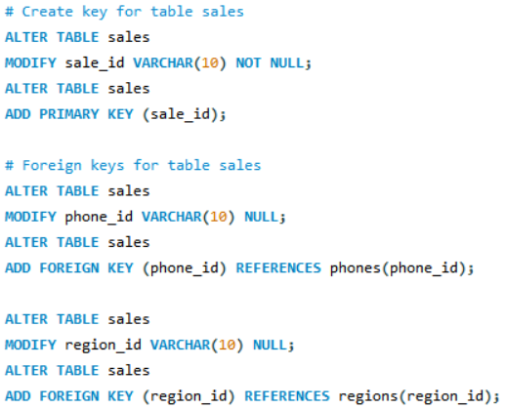
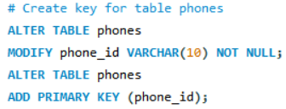
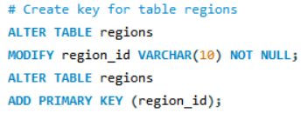
Creating Keys
MySQL cannot create an index or primary key on a TEXT/BLOB column unless we specify a prefix length. Change to VARCHAR(10)

Slide 6
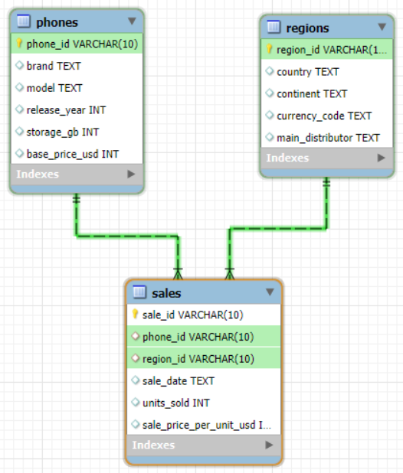
ER Diagram
Entity
- One phone model can appear in many sales transactions. But each sale refers to one specific phone.
- One region (country) can have many sales records. But each sale occurs in one specific region.
- Phones and regions have an indirect Many-to-Many (M:N) relationship. Each phone model can be sold in many regions. And each region can sell many different phones.
Attributes
One and
only One
One and
only One
One or Many

Slide 7
Insight:
What does the data tell us?

Slide 8
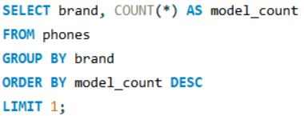
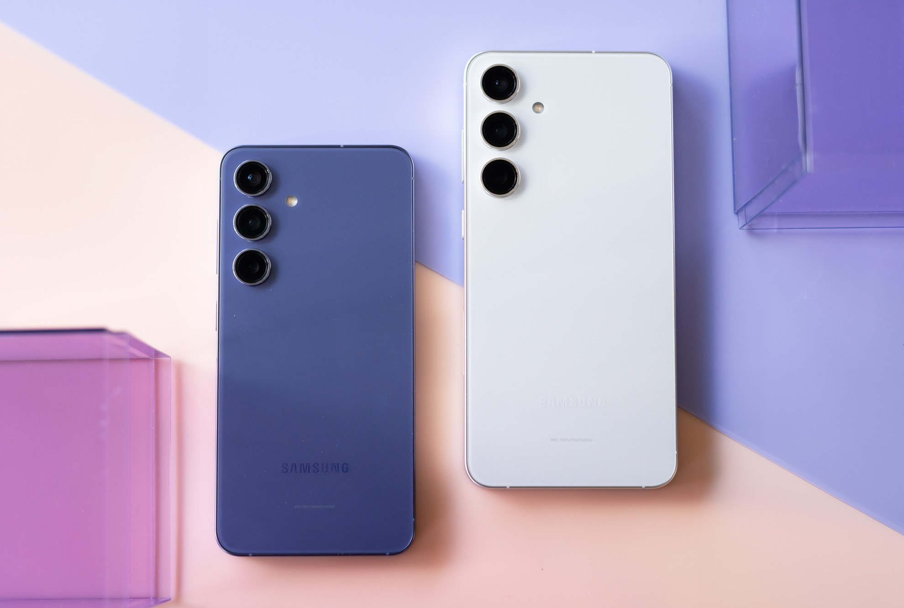
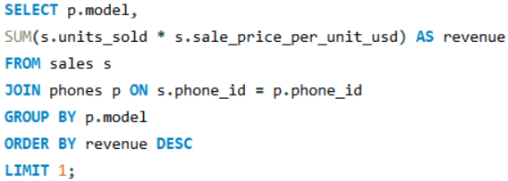
→ Samsung Is the Most Diversified Brand
→ Galaxy S24 Is the Top Revenue-Generating Model

Slide 9
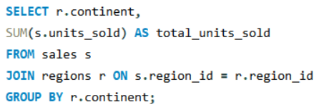
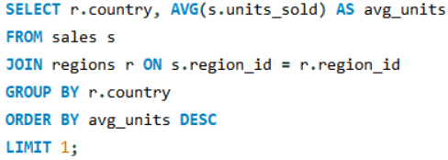
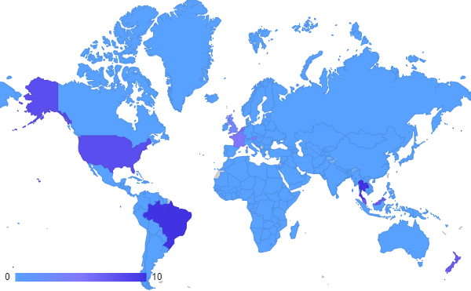
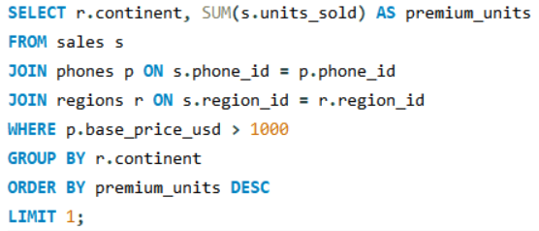
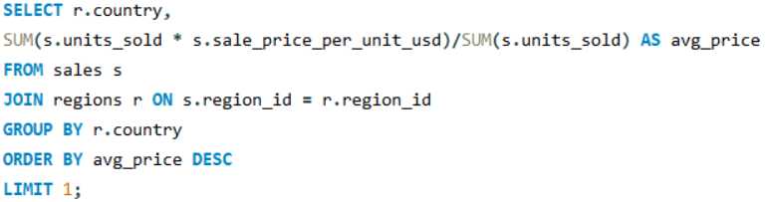
→China Has the Highest Average Units Sold Per Transaction
→ Europe Holds a Significant Portion of Global Market Activity
→ Premium Phones Sell Strongest in Asia
→ Generates the highest revenue
→ UAE Customers Pay the Highest Price Per Unit Sold

Slide 10
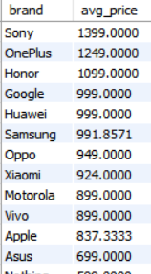
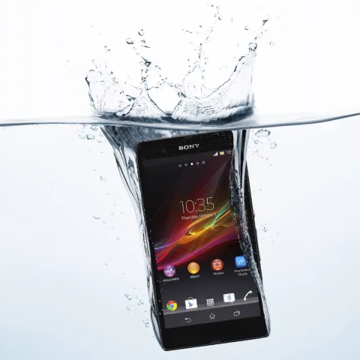
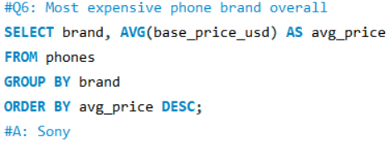
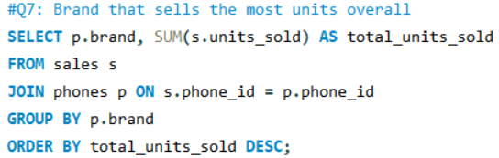
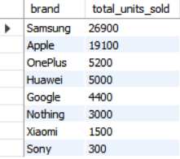
Sony!
Sony stands out as the most expensive phone brand, yet it has the lowest total units sold and does not rank among the top revenue generators.
Phones are not Sony’s main revenue driver. Sony may rely more on other product lines (e.g., TVs, cameras, gaming consoles, audio equipment) for overall revenue.
Limited focus on the mobile phone market Their strategy may be to offer premium phones for a niche audience rather than compete on volume.

Slide 11
Thank you!

